Slide 1
AI in Robotics
Semester Project Presentation
By: Jeffrey Moreno

Slide 2
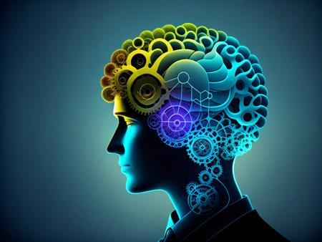
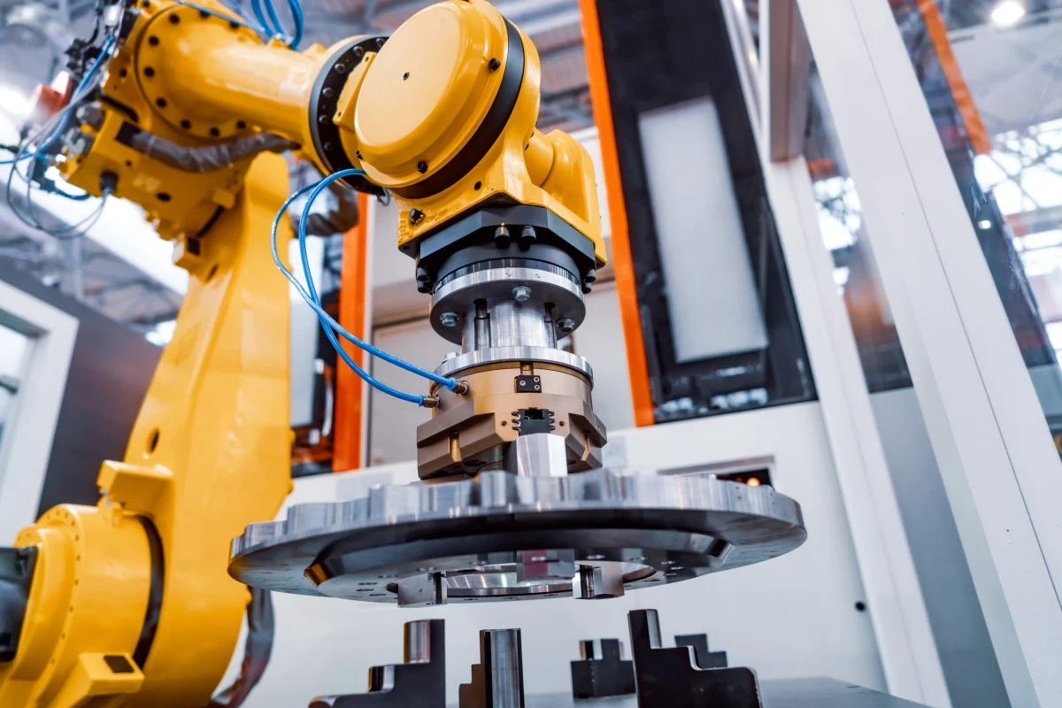
Introduction
• What is Artificial Intelligence (AI)?
• What is Robotics?
• How AI enhances robotic systems

Slide 3
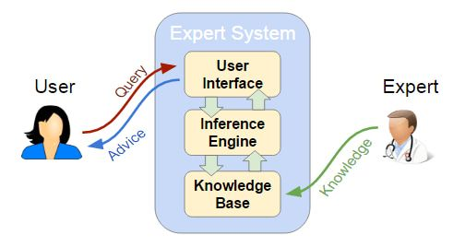
History of AI in Robotics
• Early automation
• Expert systems
• Machine learning era
• Modern intelligent robots

Slide 4
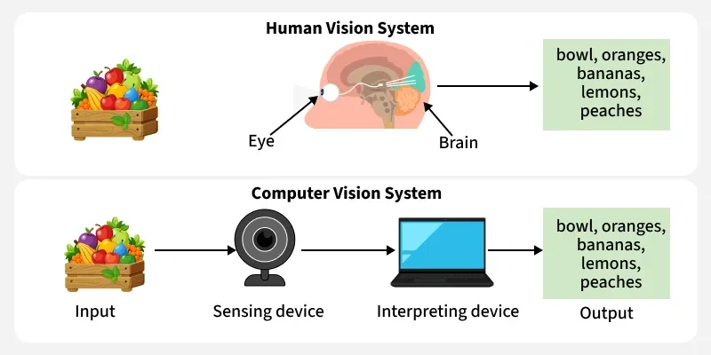
Types of AI Used in Robotics
• Machine Learning
• Deep Learning
• Computer Vision
• Natural Language Processing

Slide 5
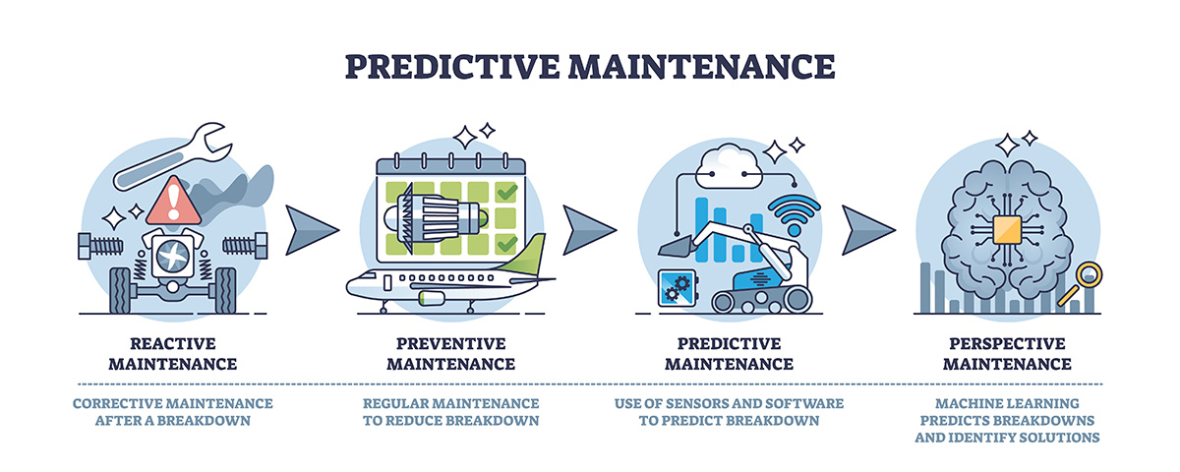
Applications: Industrial Robotics
• Manufacturing automation
• Quality control
• Predictive maintenance

Slide 6
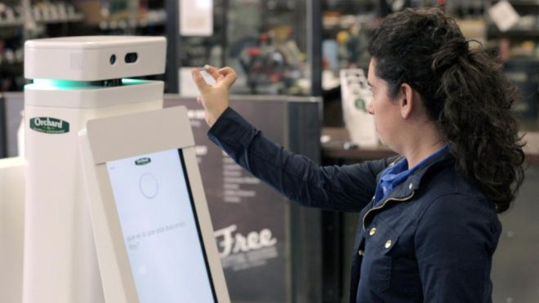
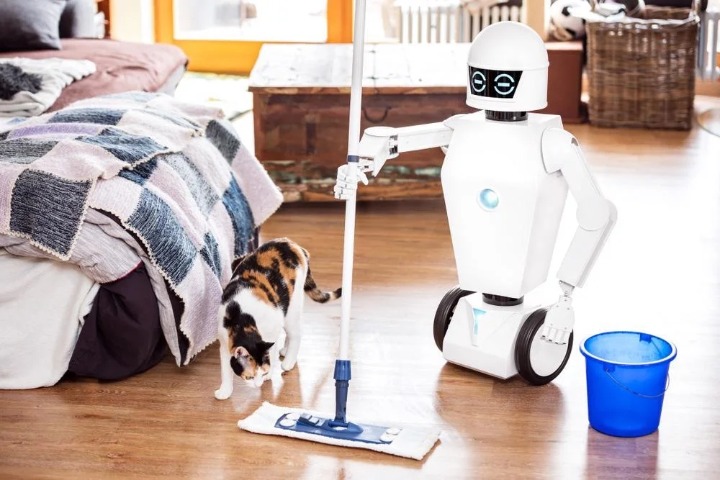
Applications: Service & Personal Robotics
• Healthcare assistance
• Domestic robots
• Customer service robots

Slide 7
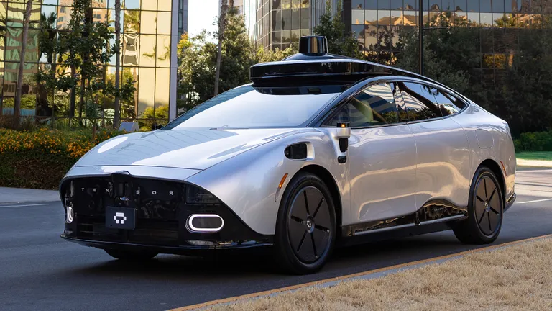
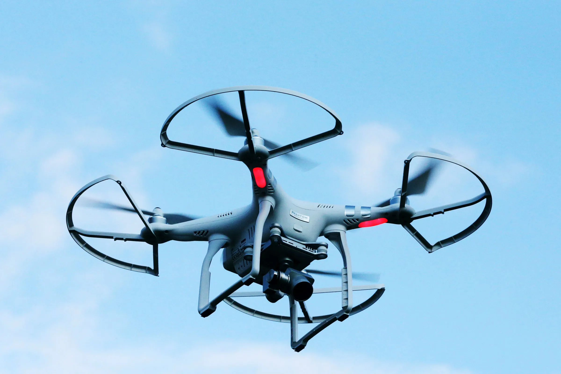
Applications: Autonomous Systems
• Self-driving vehicles
• Drones
• Exploration robots

Slide 8
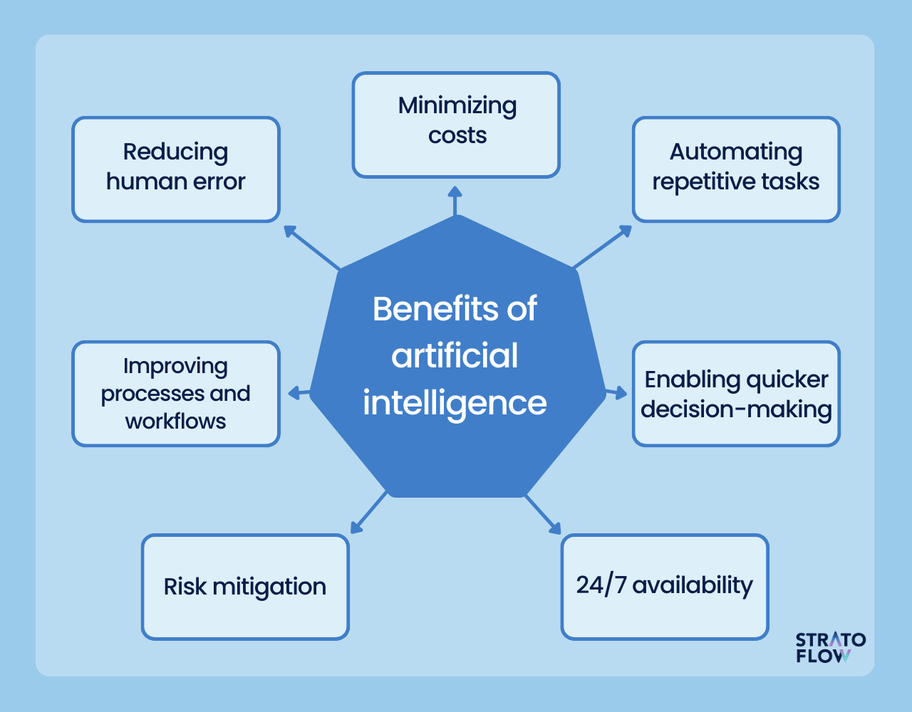
Benefits of AI in Robotics
• Increased efficiency
• Improved precision
• Enhanced adaptability
• Reduced human risk

Slide 9
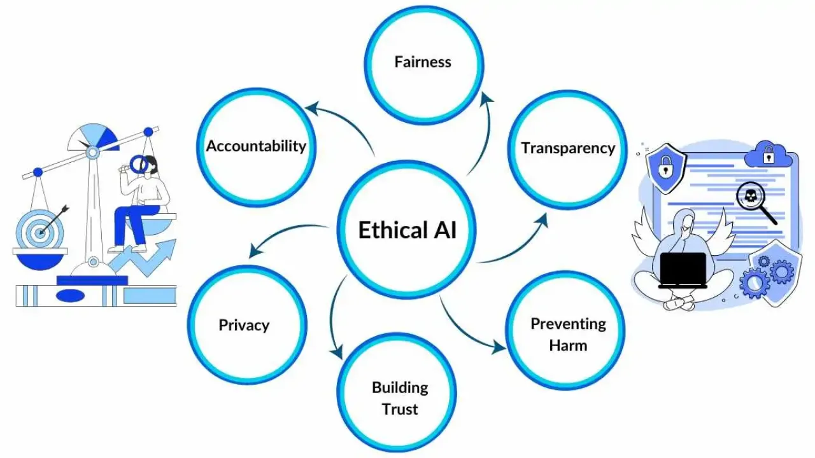
Challenges & Ethical Considerations
• Job displacement
• Safety concerns
• Data bias
• Responsible development

Slide 10
Conclusion
• AI significantly advances robotic capabilities
• Wide-ranging applications across industries
• Future improvements promise even smarter, safer robots

